Slide 1
Candidate Elimination Algorithm
For each training example d, do
If d is a positive example
Remove from G any hypothesis inconsistent with d
For each hypothesis s in S that is not consistent with d
Remove s from S
Add to S all minimal generalizations h of s such that
o h is consistent with d, and some member of G is more general than h
Remove from S any hypothesis that is more general than another hypothesis in S

Slide 2
If d is a negative example
Remove from S any hypothesis inconsistent with d
For each hypothesis g in G that is not consistent with d
Remove g from G
Add to G all minimal specializations h of g such that
o h is consistent with d, and some member of S is more specific than h
– Remove from G any hypothesis that is less general than another hypothesis in G

Slide 3
S ← minimally general hypotheses in H, G ← maximally general hypotheses in H
S₀ = ⟨∅, ∅, ∅, ∅, ∅, ∅⟩
G₀ = ⟨?, ?, ?, ?, ?, ?⟩
Initialize G to the set of maximally general hypotheses in H
Initialize S to the set of maximally specific hypotheses in H

Slide 4
Initial Values
S₀ :
G₀ :
⟨∅, ∅, ∅, ∅, ∅. ∅⟩
⟨?, ?, ?, ?, ?, ? ⟩

Slide 5
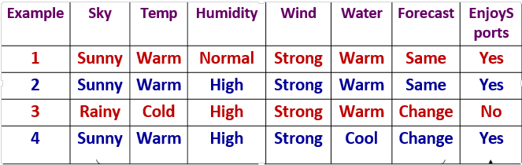

Slide 6
Example: after seeing ⟨Sunny, Warm, Normal, Strong, Warm, Same ⟩ +
S₀:
S₁:
G₀, G₁ :
⟨∅, ∅, ∅, ∅, ∅. ∅⟩
⟨Sunny, Warm, Normal, Strong, Warm, Same⟩
⟨?, ?, ?, ?, ?, ?⟩

Slide 7
Example: after seeing ⟨Sunny, Warm, High, Strong, Warm, Same ⟩ +
S₂:
G₀, G₁ G₂:
⟨Sunny, Warm, ?, Strong, Warm, Same⟩
⟨ ?, ?, ?, ?, ?, ?⟩

Slide 8
Example: after seeing ⟨Rainy, Cold, High, Strong, Warm, Change ⟩ −
S_{2,} S₃:
G₃:
G₂:
⟨Sunny, Warm, ?, Strong, Warm, Same⟩
⟨Sunny, ?, ?, ?, ?, ?⟩ ⟨?, Warm, ?, ?, ?, ?⟩ ⟨?, ?, ?, ?, ?, Same⟩
⟨ ?, ?, ?, ?, ?, ?⟩

Slide 9
Example: after seeing ⟨Sunny, Warm, High, Strong, Cool Change ⟩ +
S₃ :
S₄ :
G₄:
G₃:
⟨Sunny, Warm, ?, Strong, Warm, Same⟩
⟨Sunny, Warm, ?, Strong, ?, ?⟩
⟨Sunny, ?, ?, ?, ?, ?⟩ ⟨?, Warm, ?, ?, ?, ?⟩
⟨Sunny, ?, ?, ?, ?, ?⟩ ⟨?, Warm, ?, ?, ?, ?⟩ ⟨?, ?, ?, ?, ?, Same⟩

Slide 10
The S boundary of the version space forms a summary of the previously encountered positive examples that can be used to determine whether any given hypothesis is consistent with these examples.
The G boundary summarizes the information from previously encountered negative examples. Any hypothesis more specific than G is assured to be consistent with past negative examples.

Slide 11
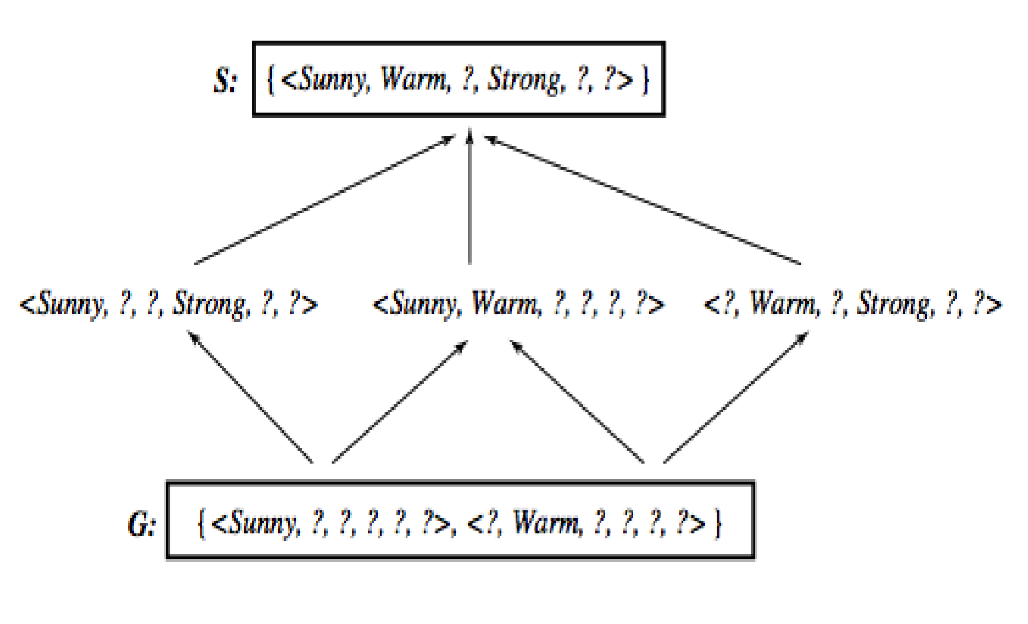
Learned Version Space

